Slide 1
Unit testing
(With a dash of API design)
December 2017
Hadley Wickham, Jenny Bryan, Di Cook

Slide 2
Motivation

Slide 3
Let’s add a column to a data frame
# Write a function that allows us to add a
# new column to a data frame at a specified
# position.
add_col(df, "name", value, where = 1)
add_col(df, "name", value, where = -1)
# Start simple and try out as we go

Slide 4
Your turn
# A useful building block is add_cols() -
# works like cbind() but can insert anywhere
add_cols <- function(x, y, where = 1) {
if (where == 1) { # first col
...
} else if (where > ncol(x)) { # last col
...
} else {
...
}
}

Slide 5
My first attempt
add_cols <- function(x, y, where = 1) {
if (where == 1) {
cbind(x, y)
} else if (where > ncol(x)) {
cbind(y, x)
} else {
cbind(x[1:where], y, x[where:nrow(x)])
}
}

Slide 6
Actually correct
add_cols <- function(x, y, where = 1) {
if (where == 1) {
cbind(y, x)
} else if (where > ncol(x)) {
cbind(x, y)
} else {
lhs <- 1:(where - 1)
cbind(x[lhs], y, x[-lhs])
}
}

Slide 7
How did I write that code?
# Some simple inputs
df1 <- data.frame(a = 3, b = 4, c = 5)
df2 <- data.frame(X = 1, Y = 2)
# Then each time I tweaked it, I re-ran
# these cases
add_cols(df1, df2, where = 1)
add_cols(df1, df2, where = 2)
add_cols(df1, df2, where = 3)
add_cols(df1, df2, where = 4)

Slide 8
Two challenges
Cmd + Enter is error prone
Looking at the outputs each run is tedious

Slide 9
We need a new workflow!
Cmd + Enter is error prone
Put code in R/ and use devtools::load_all()
Looking at the outputs each run is tedious
Write unit tests and use devtools::test()

Slide 10

We know how to create a package
usethis::create_package("~/desktop/hadcol")
usethis::use_r("add_col")
# add_cols <- function(x, y, where = 1) {
# if (where == 1) {
# cbind(y, x)
# } else if (where > ncol(x)) {
# cbind(x, y)
# } else {
# lhs <- 1:(where - 1)
# cbind(x[lhs], y, x[-lhs])
# }
# }
Or just open hadcol

Slide 11
Testing workflow
http://r-pkgs.had.co.nz/tests.html

Slide 12
Even more convenient with some conventions
usethis::use_test()
✔ Adding 'testthat' to Suggests field
✔ Creating 'tests/testthat/'
✔ Writing 'tests/testthat.R'
✔ Writing 'tests/testthat/test-add_cols.R'
● Modify 'tests/testthat/test-add_cols.R'
devtools::test()
# Or Command + Shift + T
Set up testthat infrastructure
Create test file matching script

Slide 13
So far we’ve done this:
Write R code
Reload code
Cmd/Ctrl + Shift + L
devtools::load_all()
Explore in console

Slide 14
Testthat gives a new workflow
Write R code
Reload code
Cmd/Ctrl + Shift + L
devtools::load_all()
Run automated tests
Cmd/Ctrl + Shift + T
devtools::test()

Slide 15
But why load the code?
Write R code
Run automated tests
Cmd/Ctrl + Shift + T
devtools::test()

Slide 16
Key idea of unit testing is to automate!
at_pos <- function(i) {
add_cols(df1, df2, where = i)
}
expect_named(at_pos(1), c("X", "Y", "a", "b", "c"))
expect_named(at_pos(2), c("a", "X", "Y", "b", "c"))
expect_named(at_pos(3), c("a", "b", "X", "Y", "c"))
expect_named(at_pos(4), c("a", "b", "c", "X", "Y"))
Helper function to reduce duplication
Describes an expected property of the output

Slide 17
And this automation must follow conventions
Tests for R/add_cols.R
# In tests/testthat/test-add_cols.R
test_that("can add column at any position", {
at_pos <- function(i) {
add_cols(df1, df2, where = i)
}
expect_named(at_pos(1), c("X", "Y", "a", "b", "c"))
expect_named(at_pos(2), c("a", "X", "Y", "b", "c"))
expect_named(at_pos(3), c("a", "b", "X", "Y", "c"))
expect_named(at_pos(4), c("a", "b", "c", "X", "Y"))
})

Slide 18
Tests are organised in three layers
File
One per .R file in R/
Hard to define precisely. One per “chunk” of functionality.
Test
Test
Expectation
Expectation
Test
Expectation
Expectation
Expectation
Expectation
Expectation
Expectation
Expectation
Expectation
Expectation
Very fine grained
Test
Expectation
Expectation
Expectation

Slide 19
Practice the workflow
Copy in your add_cols() function.
Create and add_cols() test file using use_test()
Put the previous expectations in a test case.
Verify that the tests pass with Cmd + Shift +T.
Add test using where = -1. Verify that it fails.

Slide 20
Why test?

Slide 21

https://unsplash.com/photos/TL5Vy1IM-uA
Writing tests improves your API

Slide 22

Improve readability or performance without changing behaviour.
https://unsplash.com/photos/gYBMinOlAUE

Slide 23

https://unsplash.com/photos/y02jEX_B0O0
When you stop work, leave a test failing

Slide 24

https://unsplash.com/photos/AVRxWIsK9Jk
If you’re bored in this class, write tests!

Slide 25
add_col

Slide 26
Next challenge is to implement add_col
df <- data.frame(x = 1)
add_col(df, "y", 2, where = 1)
add_col(df, "y", 2, where = 2)
add_col(df, "x", 2)

Slide 27
Four expectations cover 90% of cases
expect_equal(obj, exp)
expect_error(code, regexp)
expect_warning(code, regexp) expect_warning(code, NA)
expect_known_output(code)

Slide 28
Make these tests pass
# use_test("add_col")
test_that("where controls position", {
df <- data.frame(x = 1)
expect_equal(
add_col(df, "y", 2, where = 1),
data.frame(y = 2, x = 1)
)
expect_equal(
add_col(df, "y", 2, where = 2),
data.frame(x = 1, y = 2)
)
})
# Some hints on next slide

Slide 29
Hints
# Start by establishing basic form of the
# function and setting up the test cases.
add_col <- function(x, name, value, where = 1) {
}
# Make sure that you can Cmd + Shift + T
# and get two test failures before you
# continue
# More hints on the next slide

Slide 30
More hints
# You'll need to use add_cols
# add_cols() takes two data frames and
# you have a data frame and a vector
# setNames() lets you change the names of
# data frame

Slide 31
My solution
add_col <- function(x, name, value, where) {
df <- setNames(data.frame(value), name)
add_cols(x, df, where = where)
}

Slide 32
Make this test pass
test_that("can replace columns", {
df <- data.frame(x = 1)
expect_equal(
add_col(df, "x", 2, where = 2),
data.frame(x = 2)
)
})

Slide 33
My solution
add_col <- function(x, name, value) {
if (name %in% names(x)) {
x[[name]] <- value
x
} else {
df <- setNames(data.frame(value), name)
add_cols(x, df, where = where)
}
}

Slide 34
Make this test pass
test_that("default where is far right", {
df <- data.frame(x = 1)
expect_equal(
add_col(df, "y", 2),
data.frame(x = 1, y = 2)
)
})

Slide 35
My solution
add_col <- function(x, name, value,
where = ncol(x) + 1) {
if (name %in% names(x)) {
x[[name]] <- value
x
} else {
df <- setNames(data.frame(value), name)
add_cols(x, df, where = where)
}
}

Slide 36
Can we use add_col() to remove columns?
df <- data.frame(x = 1, y = 2)
expect_equal(
add_col(df, "x", NULL)
data.frame(y = 2)
)
# Should we?
# Would remove_col() be better?

Slide 37
Can we use add_col() to move columns?
df <- data.frame(x = 1, y = 2)
expect_equal(
add_col(df, "x", 1, where = 2)
data.frame(y = 2, x = 2)
)
# Should we?
# Would move_col() be better?

Slide 38
Fail fast

Slide 39
What about bad inputs?
# We need to test for errors too
add_cols(df1, df2, where = 0)
add_cols(df1, df2, where = NA)
add_cols(df1, df2, where = 1:10)
add_cols(df1, df2, where = "a")

Slide 40
For robust code, fail early
Bad input
Bad input
Useful error
Uninformative error

Slide 41
We could add to add_cols directly
add_cols <- function(x, y, where = 1) {
if (!is.numeric(where) || length(where) != 1) {
stop("`where` is not a number", call. = FALSE)
} else if (where == 0 || is.na(where)) {
stop("`where` must not be 0 or NA", call. = FALSE)
} else if (where == 1 || where <= -ncol(x)) {
cbind(x, y)
} else if (where >= ncol(x) || where == -1) {
cbind(y, x)
} else {
if (where < 0) where <- nrow(x) + where
cbind(x[1:where], y, x[where:nrow(x)])
}
}

Slide 42
But this confuses the intent of add_cols
# Better to have one function responsible
# for checking for valid inputs (and handling
# -ve values)
check_where <- function(where, ncols) {
...
}
# This also makes it easier to test because
# it's independent of add_cols

Slide 43
Use expect_error() to test for errors
expect_error(
check_where("a")
)
expect_error(
check_where("a"),
"not a number"
)
A regular expression

Slide 44
Write what you expect these functions to do
check_where(1, ncol = 3)
check_where(0)
check_where(NA)
check_where(1:10)
check_where("a")

Slide 45
Your turn
Write check_where(). It should return an integer or throw an error. I suggest you put in the same file as add_cols().
It will need to take where and number of columns.

Slide 46
My answer
check_where <- function(x, ncol) {
if (length(x) != 1 || !is.numeric(x)) {
stop("`where` must be a length one numeric vector.", call. = FALSE)
}
x <- as.integer(x)
if (x == 0 || is.na(x)) {
stop("`where` must not be zero or missing", call. = FALSE)
} else {
x
}
}

Slide 47
A few conventions for stop()
Always use call. = FALSE
Surround variable names in `...`, and strings in '...'
Message should say what is needed, compared to what was provided

Slide 48
Use expect_error() to test for errors
expect_error(
check_where("a")
)
expect_error(
check_where("a"),
"not a number"
)
A regular expression

Slide 49
Your turn
Write tests to ensure that check_where() only allows valid inputs. (Where should the tests live?)

Slide 50
My tests
# check_where() lives in same file as add_cols()
# so tests should live in test-add_cols()
test_that("where must be valid value", {
expect_error(check_where("a"), "length one numeric vector")
expect_error(check_where(1:10), "length one numeric vector")
expect_error(check_where(0), "not be zero or missing")
expect_error(check_where(NA_real_), "not be zero or missing")
})

Slide 51
What about negative values?
1
2
3
4
-4
-3
-2
-1
x | y | z
1 | a | 4.5
2 | b | 1.2
4 | c | 6.7

Slide 52
Your turn
Write some tests that establish what check_where() should return for negative positions. Implement the code to make the tests pass.

Slide 53
Tests

Slide 54
Updated check_where()

Slide 55
Other side effects
# Check for warning and something else
expect_warning(out <- foo(), "blah")
expect_equal(out, 10)
# Checking for absence
expect_warning(code, NA)
expect_message(code, NA)
expect_output(code, NA)

Slide 56
Test coverage

Slide 57
Useful to know which lines have been tested
# Powered by the covr package
devtools::test_coverage()

Slide 58
Your turn
Run covr and verify that every line has been tested.
Have we missed anything? Can you add a test that checks it?

Slide 59
You can also automate
GitHub = publish your code online
Travis = run code every time your code changes
Codecov = display which functions are tested

Slide 60
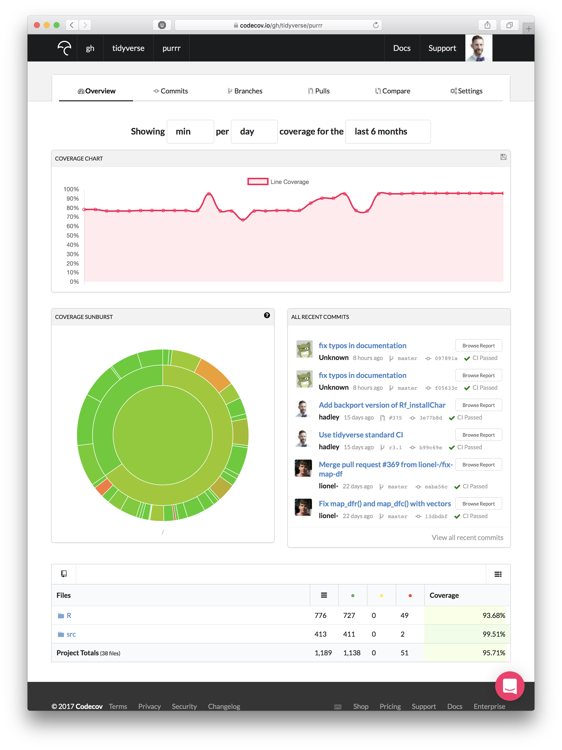

Slide 61
Ignore!
Click!

Slide 62
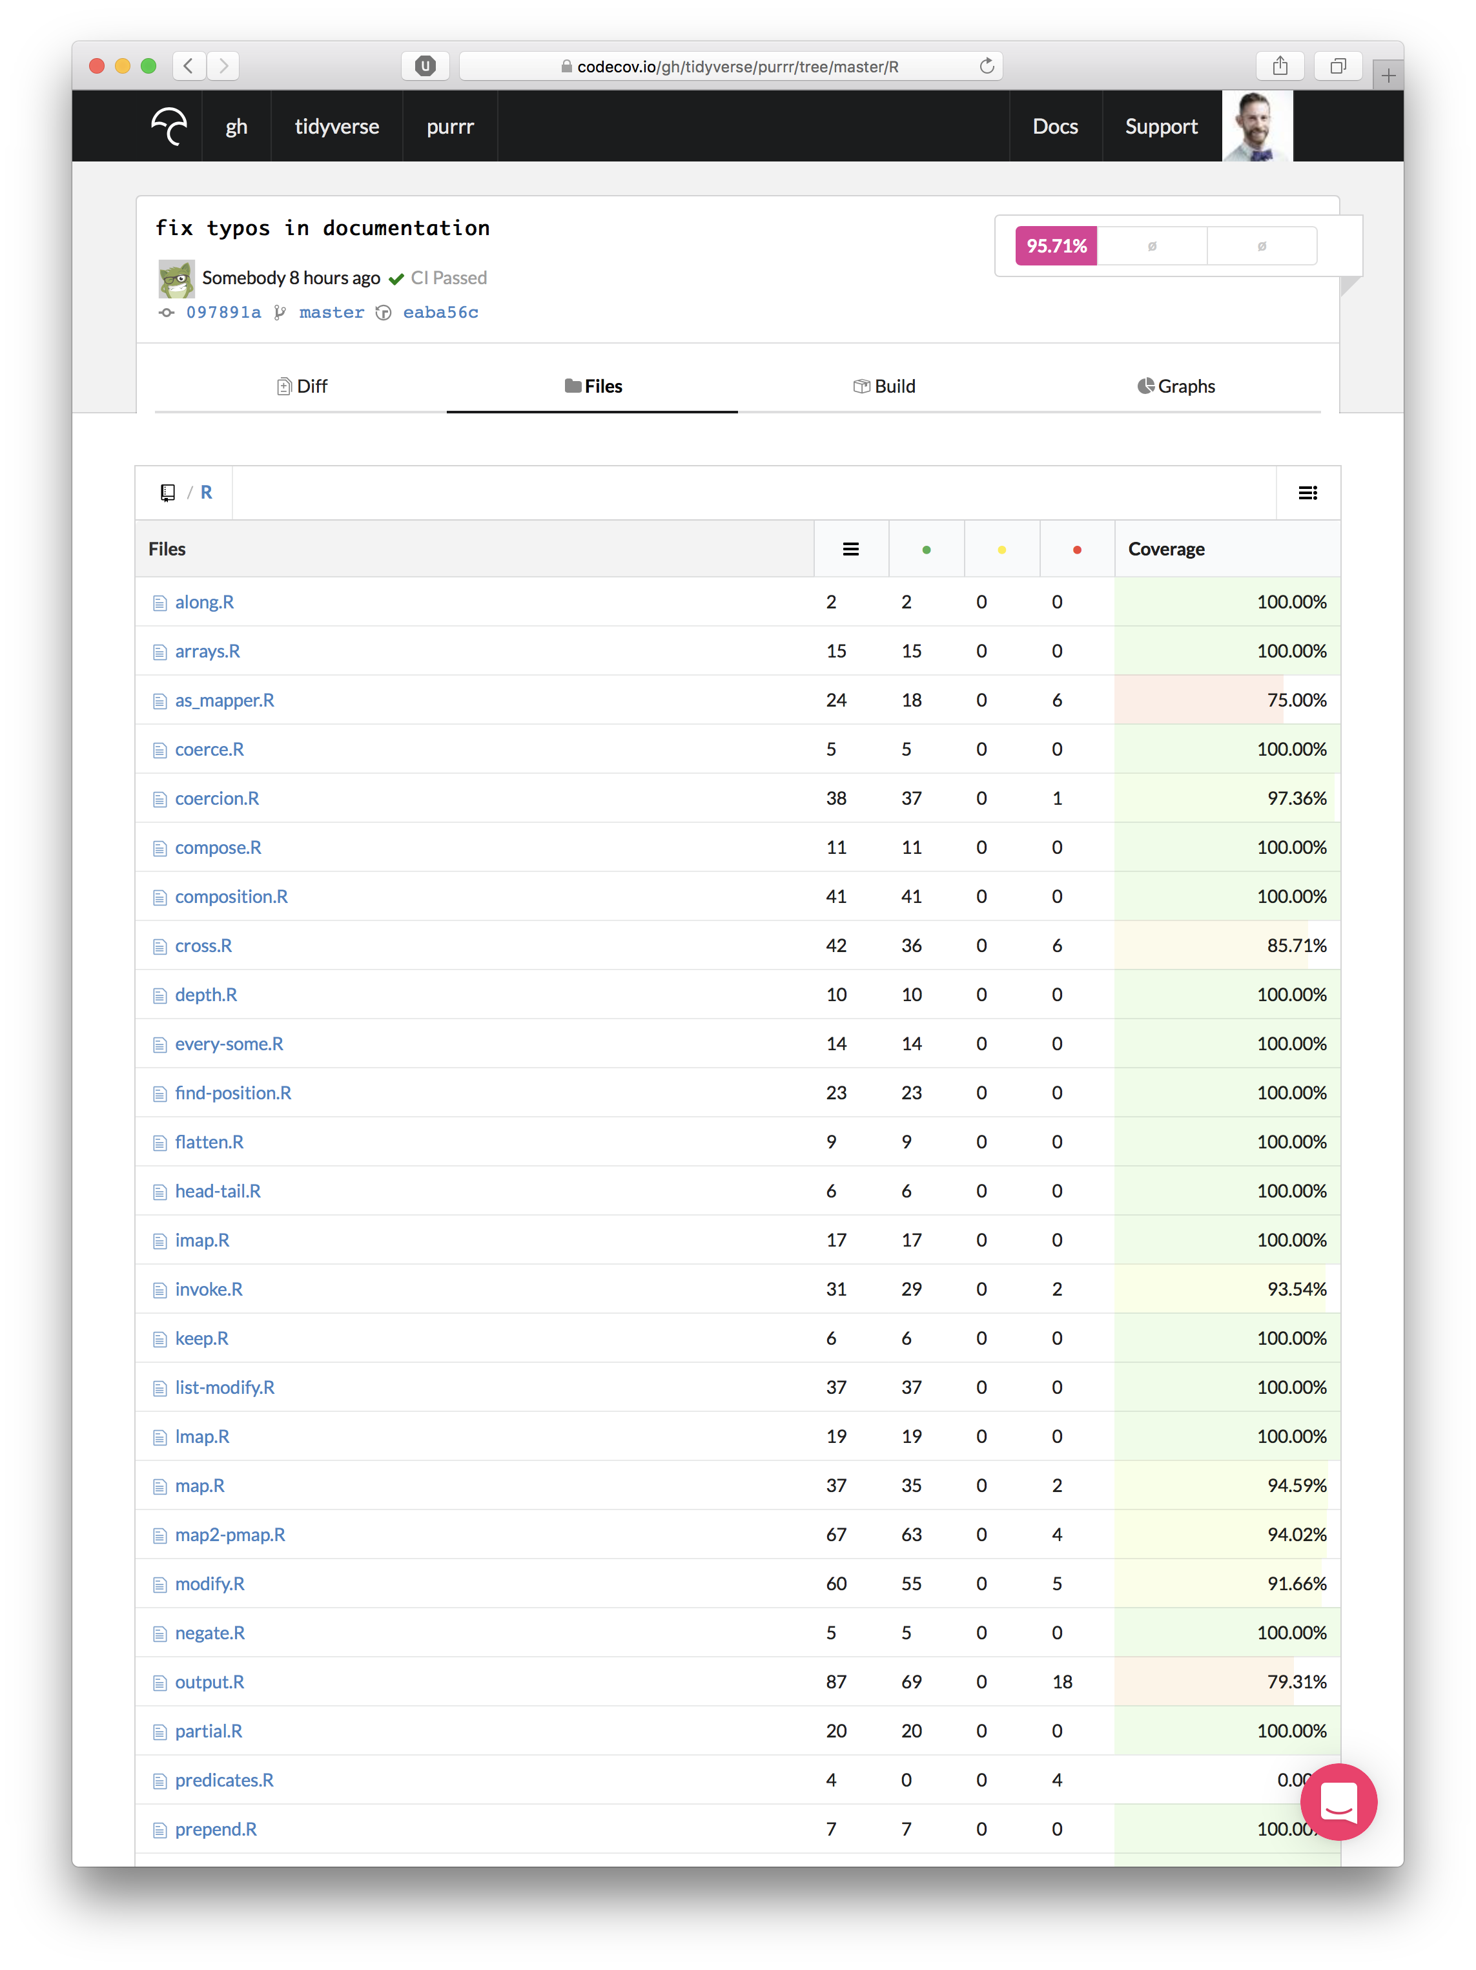

Slide 63
